Slide 1
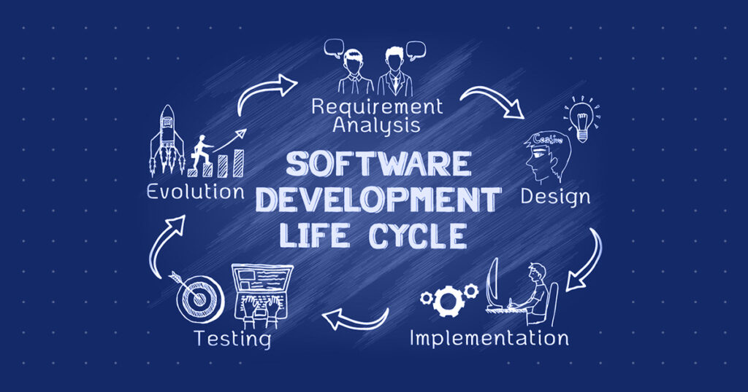
Software Development Life Cycle (SDLC)
Software Engineering Life Cycle (SELC)
Notes:
stage 1:- Plan (A - Z)
Stage 2 :- Develop & Merging the Code
Stage 3 :- Building the Code -> create build file ---> Application
Stage 4 :- Testing
Stage 5:- Deploy (In server -> Client and World)
Agile Methodologies - I Know, If my team is heading correct path quick feedback from client
1. one functionlity - Sprint 1- Develop
2. Merging Github and git
3. Sprint by sprint (Planning new feature, Developing, Building and testing again)
Everything is done automatically by pulling the merge code form github , building , testing -CI (Continuous Integration)
If build and test cases are successfully completed then ---> Deploy CD (Continous Deployment)
CI CD
Continues Intergration/Continuous Deployment
Jenkins
Devops---> Develop +Opeartion
The operation team is the one who deploys the application

Slide 2
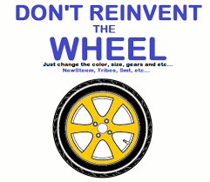
Software Engineering
Software engineering is an engineering approach to develop software.
The engineering approach evolved and was refined by people specialized or years of experience in this domain.
When the entire experience or learning process is validated and verified by some mathematical model, these learning experiences are consolidated in written documents or guidelines.
Software engineering can also be defined as a systematic, disciplined, and quantifiable approach for developing, operating, and maintaining software.

Slide 3
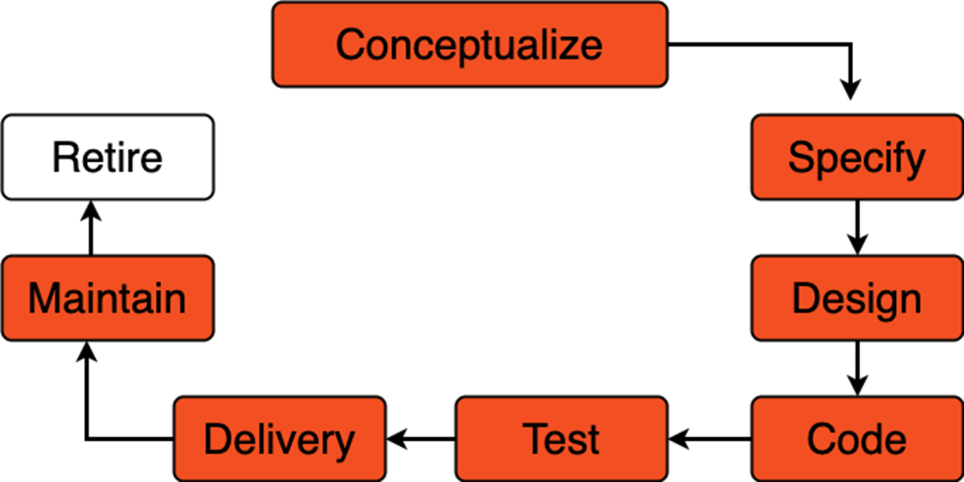
Software Development Life Cycle (SDLC)
The Software Engineering Life Cycle (SELC), also known as the Software Development Life Cycle (SDLC), is a structured process used to develop high-quality software systematically and efficiently. It outlines the phases involved in software creation, from initial planning to maintenance after deployment.

Slide 4
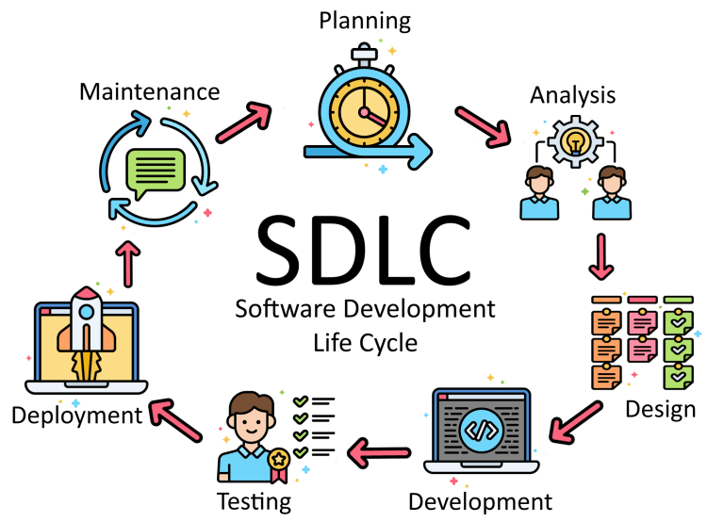
Key Phases of the SDLC
Requirement Analysis
Define the architecture, components, interfaces, and data flow.
Includes both high-level design (HLD) and low-level design (LLD).
System Design
Developers write code based on the design documents.
Follows coding standards and best practices.
Implementation (Coding)
Verify that the software works as intended.
Includes unit testing, integration testing, system testing, and user acceptance testing (UAT).
Testing
Release the software to the production environment.
Can be done in stages (e.g., beta release, full release).
Deployment
Release the software to the production environment.
Can be done in stages (e.g., beta release, full release).
Maintenance
Fix bugs, update features, and ensure the software continues to meet user needs.
Includes corrective, adaptive, and perfective maintenance.

Slide 5
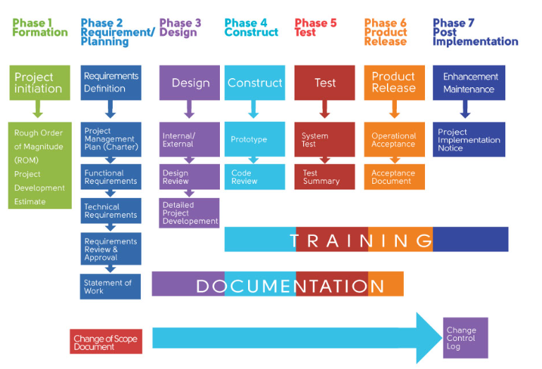
Analysis
Product Owner
Project Manager
Design
System Architect
UX/UI Designer
Development
Front-End Developer
Back-End Developer
Testing
Deployment
Maintenance
Users
Business Analyst
Chief Technology Officer (CTO)
Solution Architect
QA Engineer
Tester
DevOps
Data Administrator
DevOps
Testers
Support Manager
App Admin
SDLC Phases

Slide 6
Project Management
Project Management is the discipline of planning, organizing, and managing resources to successfully complete specific goals and deliverables within a defined timeframe and budget.
Software development teams to plan, track, and manage work across various stages of the development lifecycle.
Streamline workflows, improve collaboration, and ensure that projects are delivered on time and within budget.

Slide 7
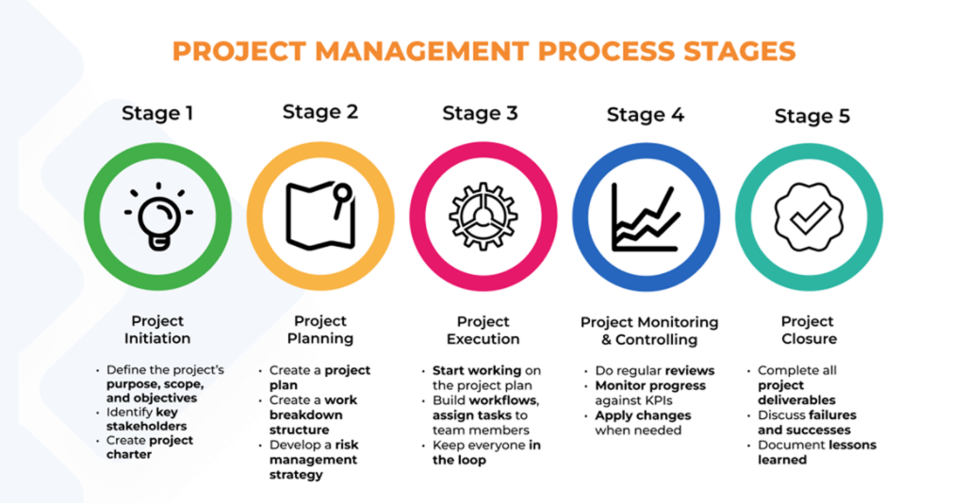

Slide 8
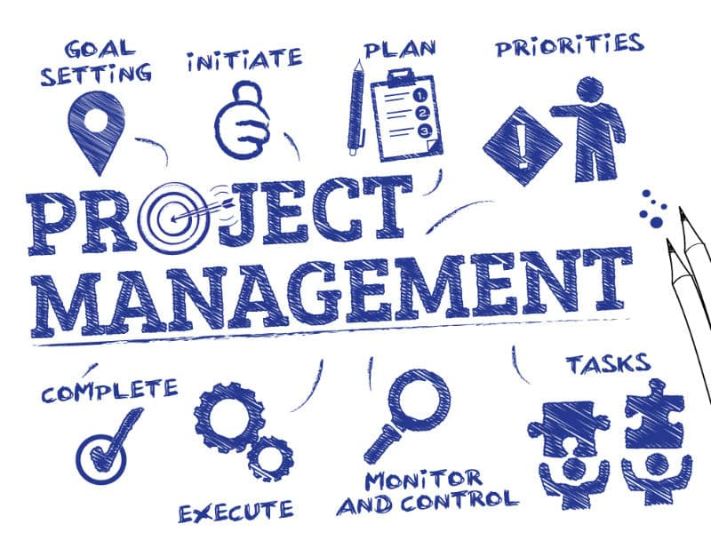
Key Objectives of Project Management
Deliver the project on time
Stay within budget
Meet the quality standards
Satisfy stakeholder expectations

Slide 9
Core Components of Project Management
Initiation
Define the project scope and objectives
Identify stakeholders
Conduct feasibility studies
Planning
Develop a project plan and schedule
Allocate resources and budget
Identify risks and mitigation strategies
Execution
Coordinate people and resources
Manage tasks and communication
Ensure quality and progress
4. Monitoring & Controlling
Track performance and progress
Adjust plans as needed
Manage changes and risks
5. Closure
Deliver final product or service
Release resources
Document lessons learned

Slide 10

Project Management Tools
Project Management Tools are software applications designed to help individuals and teams plan, organize, manage, and track projects efficiently. These tools streamline workflows, improve collaboration, and ensure that projects are delivered on time and within budget.

Slide 11
Popular Project Management Tools
Tool | Best For | Key Features
Jira | Software development teams | Agile boards, issue tracking
Trello | Simple task management | Kanban boards, checklists
Asana | Team collaboration | Task lists, timelines, automation
ClickUp | All-in-one project management | Docs, goals, time tracking
Microsoft Project | Enterprise-level planning | Gantt charts, resource management
Monday.com | Visual project tracking | Dashboards, automation
Notion | Flexible workspace | Notes, databases, task boards
Basecamp | Remote team collaboration | Messaging, to-dos, schedules

Slide 12
Key Features of Project Management Tools
Task Management
Create, assign, and prioritize tasks
Set deadlines and track progress
Scheduling
Gantt charts, calendars, and timelines
Resource allocation and workload balancing
Collaboration
Team communication (chat, comments)
File sharing and document management
Reporting & Analytics
Progress tracking
Budget and time tracking
Performance metrics
Integration
Connect with tools like Slack, GitHub, Jira, etc.

Slide 13
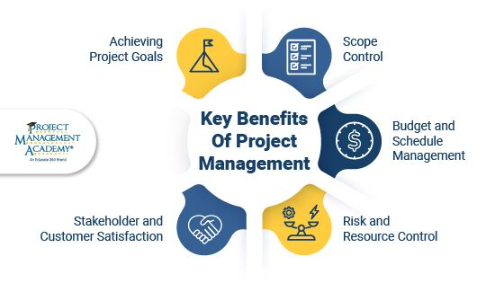
Benefits of Using Project Management Tools
Better team coordination
Clear visibility into project status
Efficient resource management
Reduced risks and delays
Improved productivity and accountability

Slide 14
Popular Project Management Methodologies
Methodology | Description
Waterfall | Linear and sequential approach
Agile | Iterative and flexible, ideal for software
Scrum | Agile framework with sprints and roles
Kanban | Visual workflow management
Lean | Focuses on minimizing waste
PRINCE2 | Structured, process-driven method

Slide 15
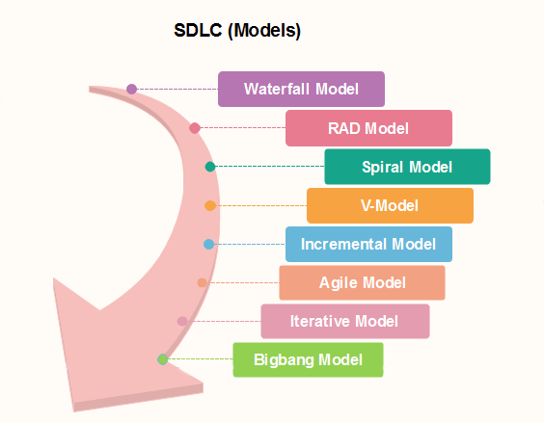
SDLC Methodologies
Iterative Waterfall Model
V Model
Evolutionary Model
Prototyping Model
Incremental Model
Spiral Model
Agile Model
RAD Model
Unified Process Model

Slide 16
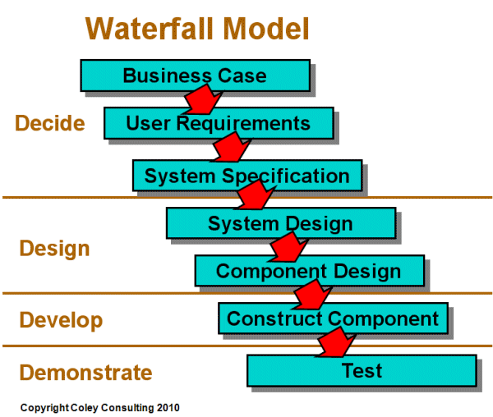
Iterative Waterfall Model
The Waterfall method is a traditional and sequential approach to software development . In this model, the development process flows steadily distinct phases, must be fully completed before the next one begin and there is typically no going back to a previous phase to make change. It is called waterfall because of the way it falls down. `

Slide 17
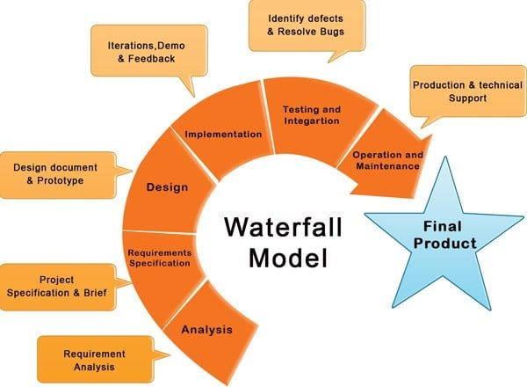
Phases of the Waterfall Model
Requirements Gathering and Analysis
All possible requirements of the system are gathered and documented. This phase is crucial because changes are hard to accommodate later.
System Design
Based on the requirements, the system architecture and design are created. This includes hardware and software specifications.
Implementation (Coding)
Developers write code based on the design documents. Each unit is developed and tested individually.
Integration and Testing
All units are integrated into a complete system and tested to ensure they work together and meet the requirements.
Deployment
The system is delivered to the customer and deployed in the production environment.
Maintenance
After deployment, the system enters the maintenance phase where bugs are fixed and updates may be made.

Slide 18
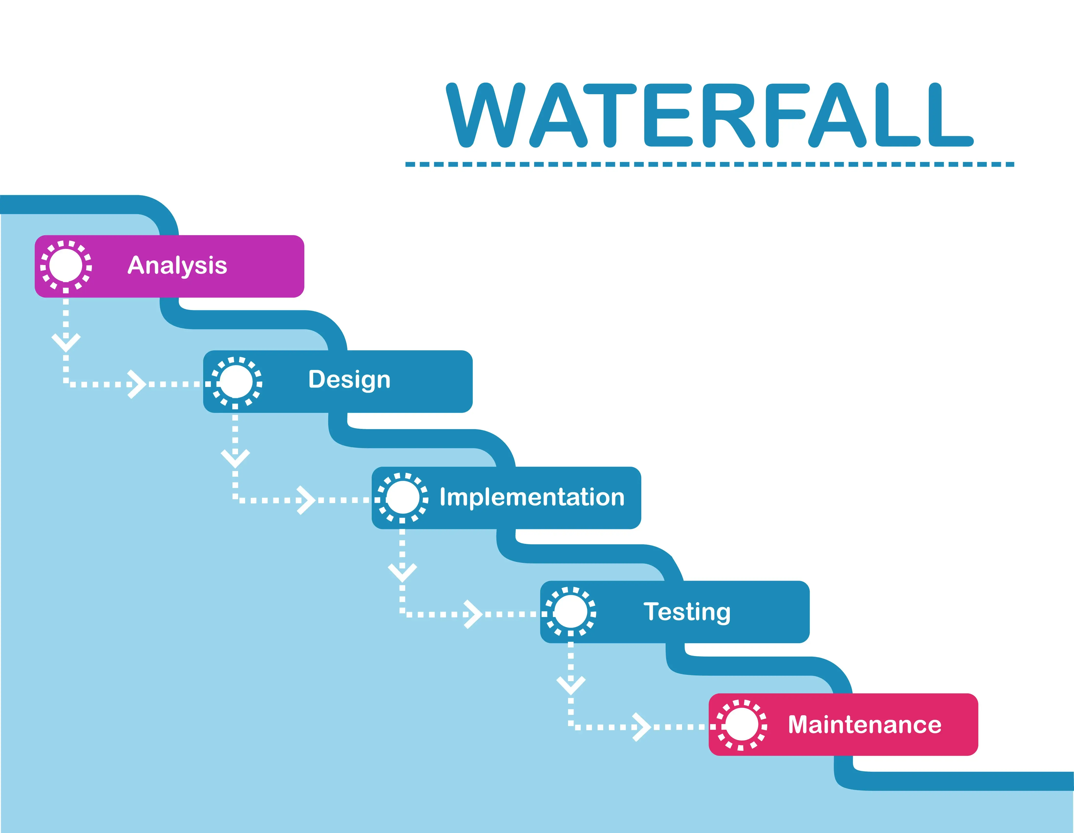
Advantages
Simple and easy to understand.
Well-structured and disciplined.
Works well for projects with clearly defined requirements.
Disadvantages
Inflexible to changes once the process starts.
Poor model for long or ongoing projects.
Late discovery of issues due to delayed testing.

Slide 19
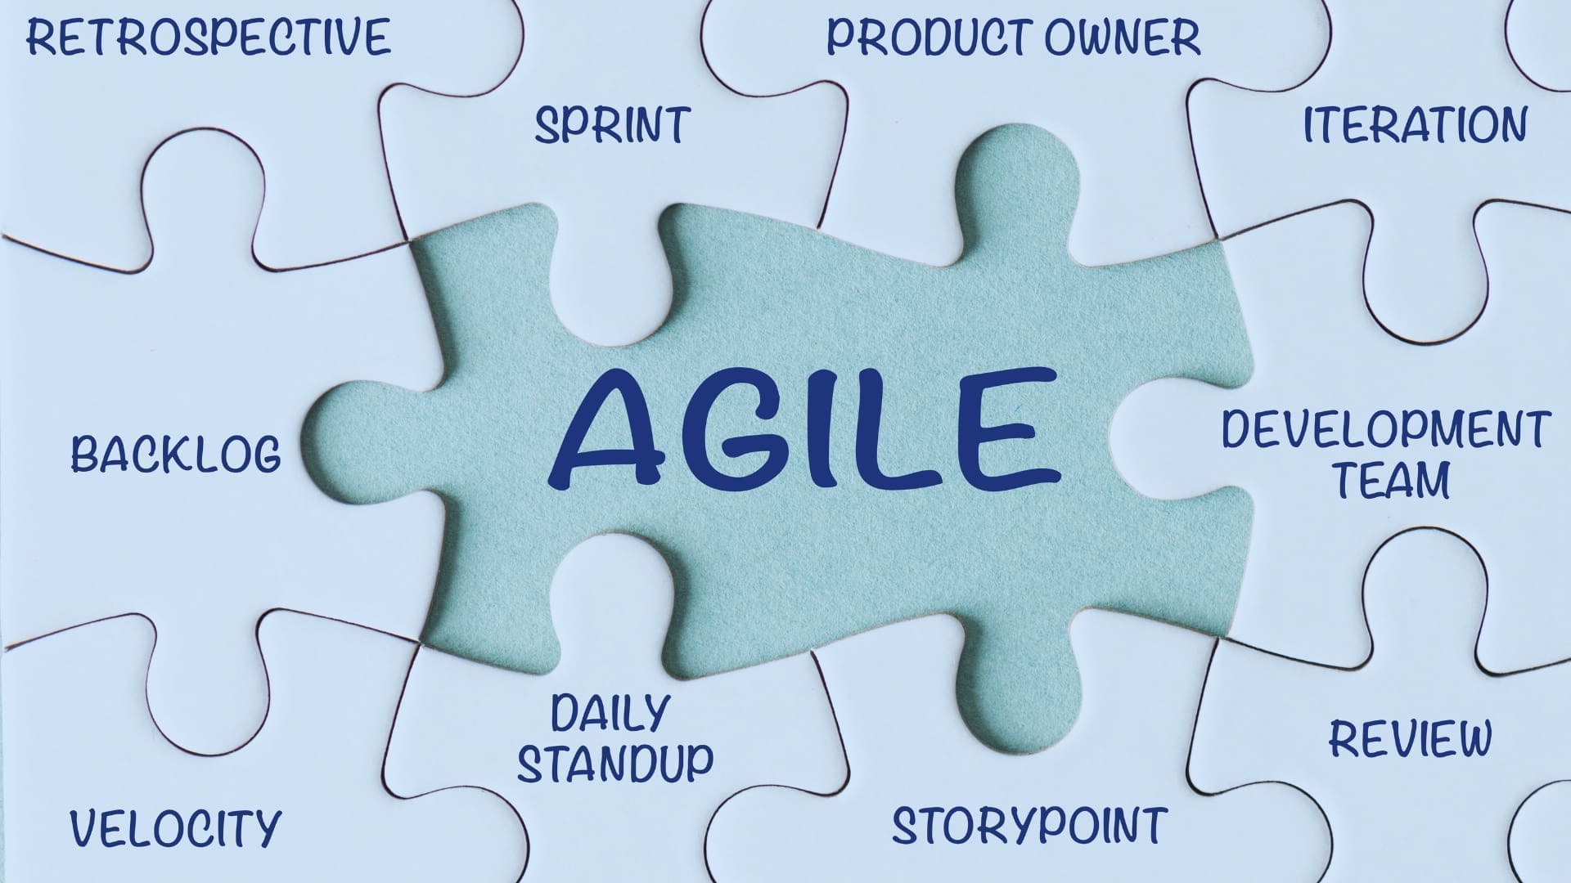

Slide 20
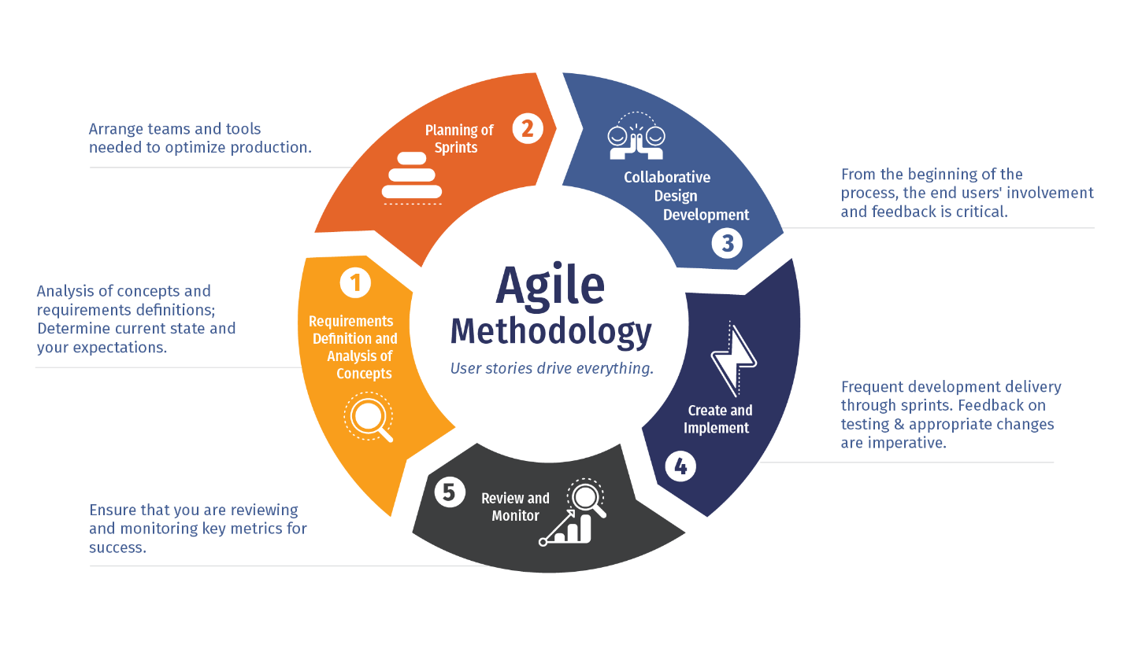
Agile Methodologies
Agile Methodologies in the SDLC refer to a group of approaches that emphasize flexibility, collaboration, customer feedback & rapid delivery of functional software. Agile is designed to handle changing requirements and deliver value incrementally.

Slide 21
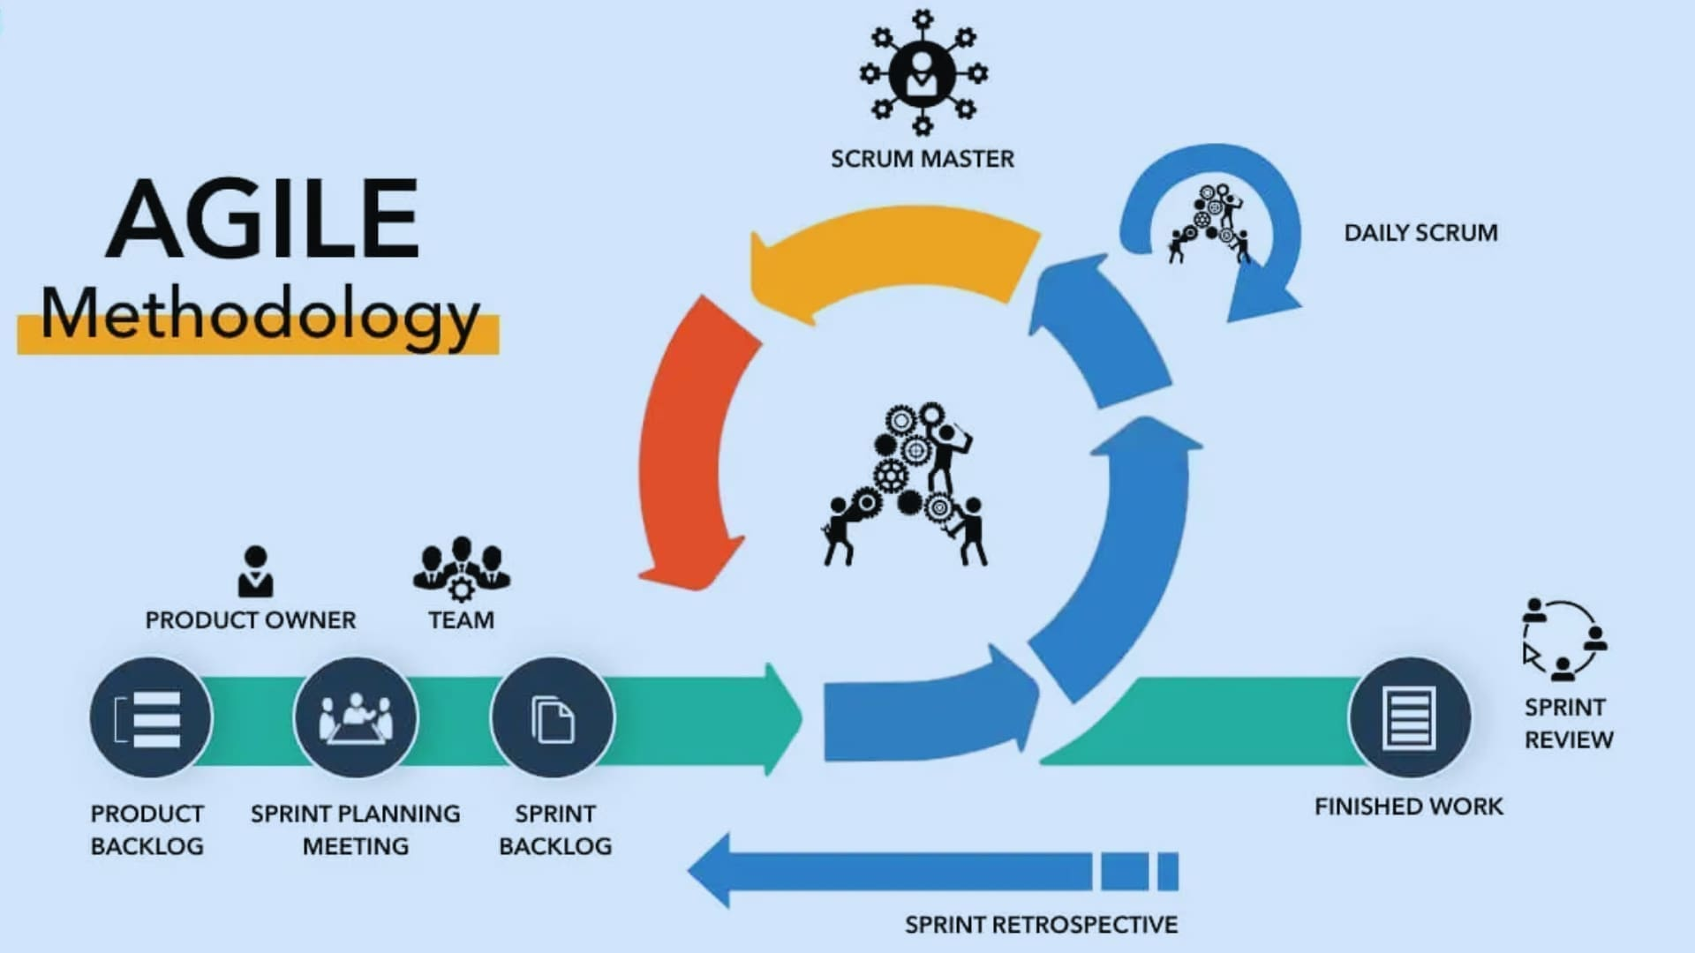

Slide 22
Agile Manifesto 4 Values and 12 Principles.
02. Changing Requirement
03. Frequent Delivery
04. Promoting Collaboration
05. Motivated Individuals
06. Face to Face communication
07. Maintain a Constant pace
08. Measure Progress
09. Technical Excellence
10. Simplicity
11. Self organized team
12. Continues Improvements
01. Customer Satisfaction
Through this work we have come to Value & Principles
1. Individuals and interactions over processes and tools. 2. Working software over comprehensive documentation. 3. Customer collaboration over contract negotiation. 4. Responding to change over following a plan.

Slide 23
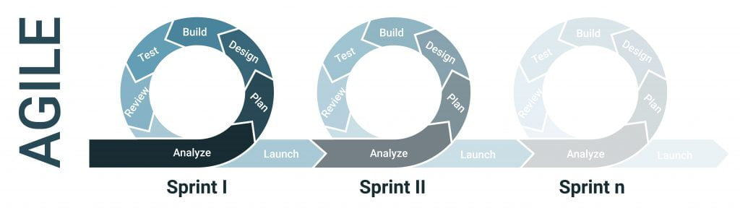
Benefits of Agile
Faster delivery of usable software.
Better adaptability to changing requirements.
Continuous customer involvement.
Improved team collaboration.

Slide 24
Popular Agile Methodologies:
Scrum – Uses sprints, roles like Product Owner and Scrum Master.
Kanban – Visual workflow management with continuous delivery.
Extreme Programming (XP) – Focuses on technical excellence and frequent releases.
Lean Software Development – Emphasizes efficiency and eliminating waste.

Slide 25

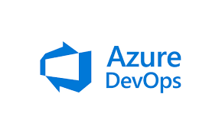



Slide 26
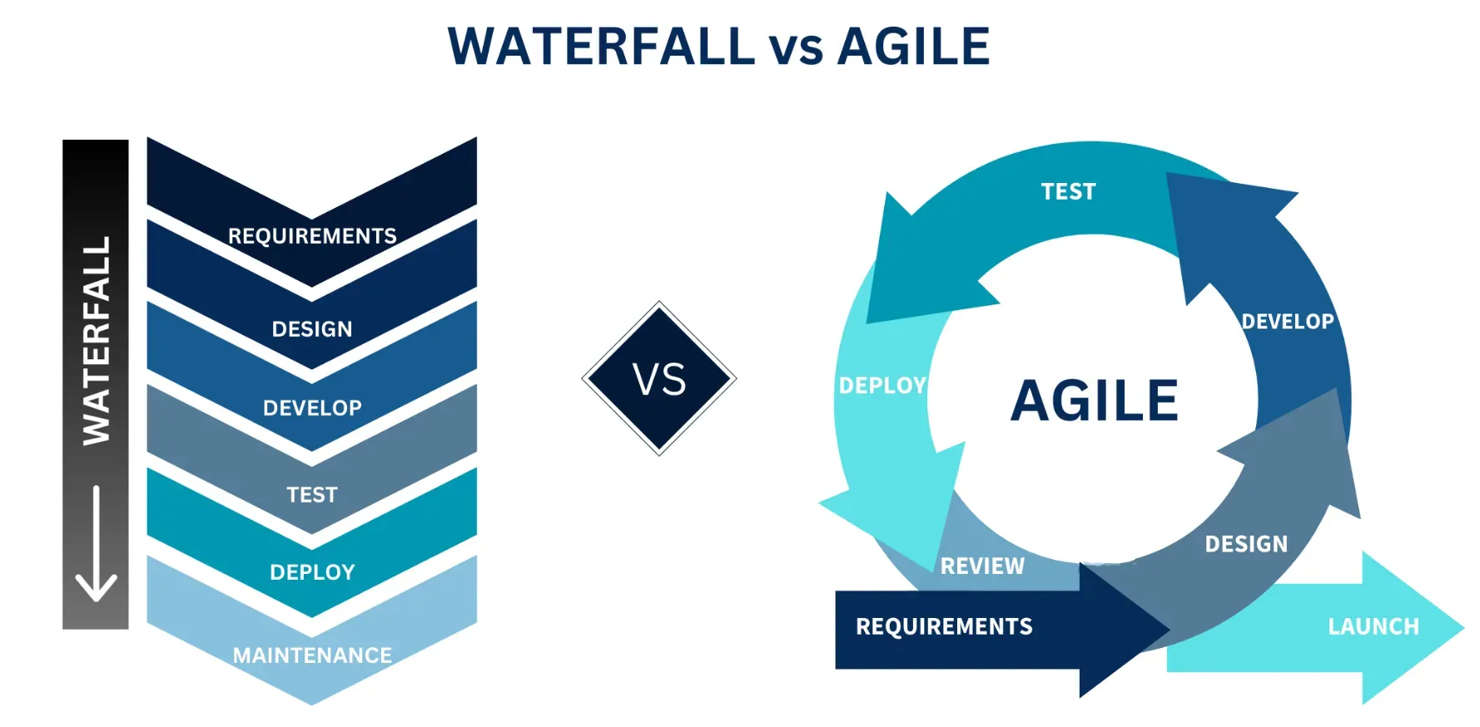

Slide 27
Aspect | Waterfall | Agile
Approach | Linear and sequential | Iterative and incremental
Flexibility | Rigid – changes are difficult once a phase is completed | Highly flexible – changes can be made at any time
Phases | Distinct phases: Requirements → Design → Build → Test | Continuous cycles of planning, development, and feedback
Customer Involvement | Minimal after requirements are gathered | High – customer feedback is integral throughout
Testing | Done after implementation | Continuous testing throughout development
Delivery | Single final product delivery | Frequent, small releases (sprints)
Best For | Projects with well-defined, unchanging requirements | Projects with evolving requirements and user feedback
Risk Management | High risk – issues found late | Lower risk – early detection and correction of issues
Documentation | Extensive documentation | Lightweight documentation
Team Collaboration | Siloed roles and responsibilities | Cross-functional, collaborative teams

Slide 28
DevOps
DevOps is a software development methodology that combines software development (Dev) with information technology operations (Ops) participating together in the entire service lifecycle, from design through the development process to production support.

Slide 29
DevOps
DevOps is a combination of "Development" and "Operations", and it refers to a set of practices, tools, and cultural philosophies that aim to automate and integrate the processes between software development and IT operations.

Slide 30
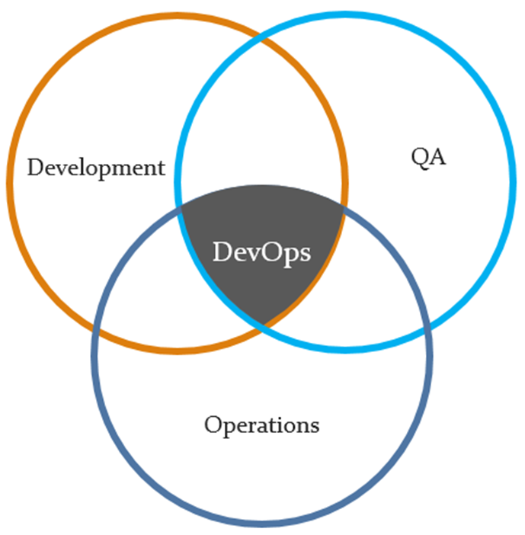
Core Goals of DevOps
Faster delivery of software
Improved collaboration between development and operations teams
Continuous integration and deployment (CI/CD)
High software quality and reliability
Rapid response to change and feedback

Slide 31
Key Components of DevOps
Continuous Integration (CI) Developers frequently merge code changes into a shared repository, triggering automated builds and tests.
Continuous Delivery (CD) Code is automatically prepared for release to production, ensuring it's always in a deployable state.
Infrastructure as Code (IaC) Managing infrastructure (servers, networks) using code and automation tools like Terraform or Ansible.
Monitoring and Logging Tools like Prometheus, Grafana, and ELK Stack help track performance and detect issues.
Automation Automating repetitive tasks like testing, deployment, and configuration.
Collaboration and Communication Tools like Slack, Jira, and Confluence help teams work together more effectively.

Slide 32
Popular DevOps Tools
CI/CD: Jenkins, GitHub Actions, GitLab CI, CircleCI
Configuration Management: Ansible, Puppet, Chef
Containerization: Docker, Kubernetes
Monitoring: Prometheus, Grafana, ELK Stack
Version Control: Git

Slide 33
Benefits of DevOps
Faster time to market
Better product quality
More stable operating environments
Improved team collaboration
Efficient use of resources
Notes:
https://medium.com/@raycad.seedotech/devops-methodology-and-process-dde388eb65bd

Slide 34
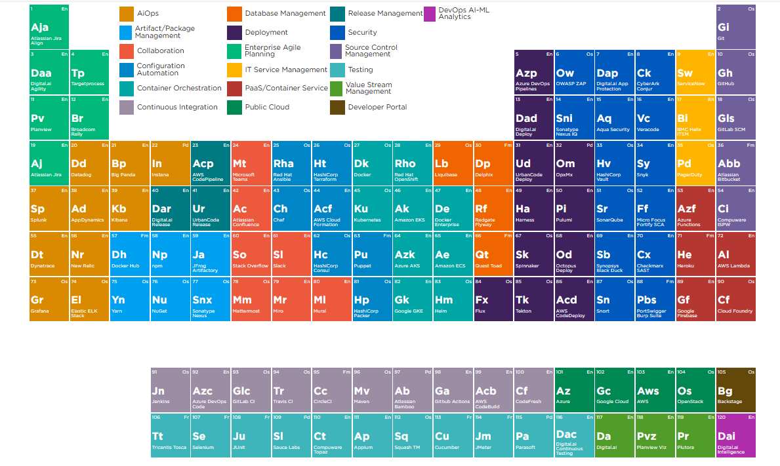
DevSecOps Tools Periodic Table
Notes:
Periodic Table of DevSecOps Tools | Digital.ai

Slide 35
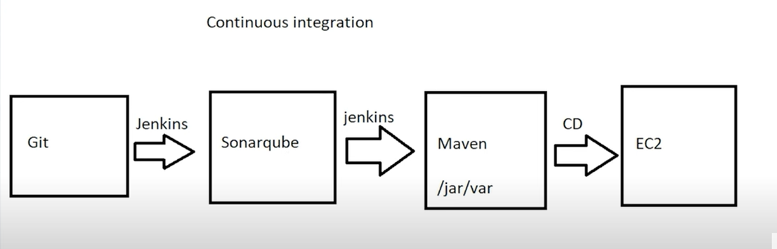

Slide 36
Continuous Integration & Continuous Delivery/Deployment.CI/CD
It's a set of practices used in modern software development to automate and streamline the process of building, testing, and releasing code.
Continuous Integration (CI)
Continuous Delivery (CD)
CI is the practice of:
Frequently merging code changes into a shared repository (often multiple times a day).
Automatically building and testing the code after each change.
Catching bugs early by running automated tests.
CD ensures that:
Code is automatically prepared for release to production.
Every change passes through automated tests and quality checks.
Releases can be done at any time with minimal effort.
Continuous Deployment
Every change that passes tests is automatically deployed to production

Slide 37
CI/CD Benefits
Jenkins
GitHub Actions
GitLab CI/CD
CircleCI
Azure DevOps
Popular CI/CD Tools
Developer pushes code to GitHub.
CI server (like Jenkins, GitHub Actions) runs tests and builds the code.
If successful, CD process packages the code and deploys it to staging or production.
CI/CD Pipeline Example
Reduces integration issues.
Improves code quality.
Speeds up development.

Slide 38
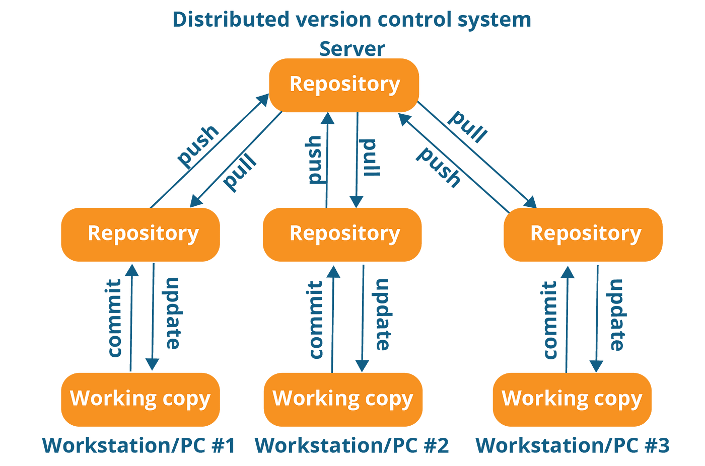
Version Control System
Version Control System (VCS) is a software tool that tracks and manages changes to files and documents over time. While most commonly associated with source code in software development, a VCS can be used for any type of file where tracking changes and collaboration are important.
VCS tool that helps developers manage changes to source code over time. It allows multiple people to work on a project simultaneously, keeps track of every modification, and makes it easy to revert to earlier versions if needed.

Slide 39
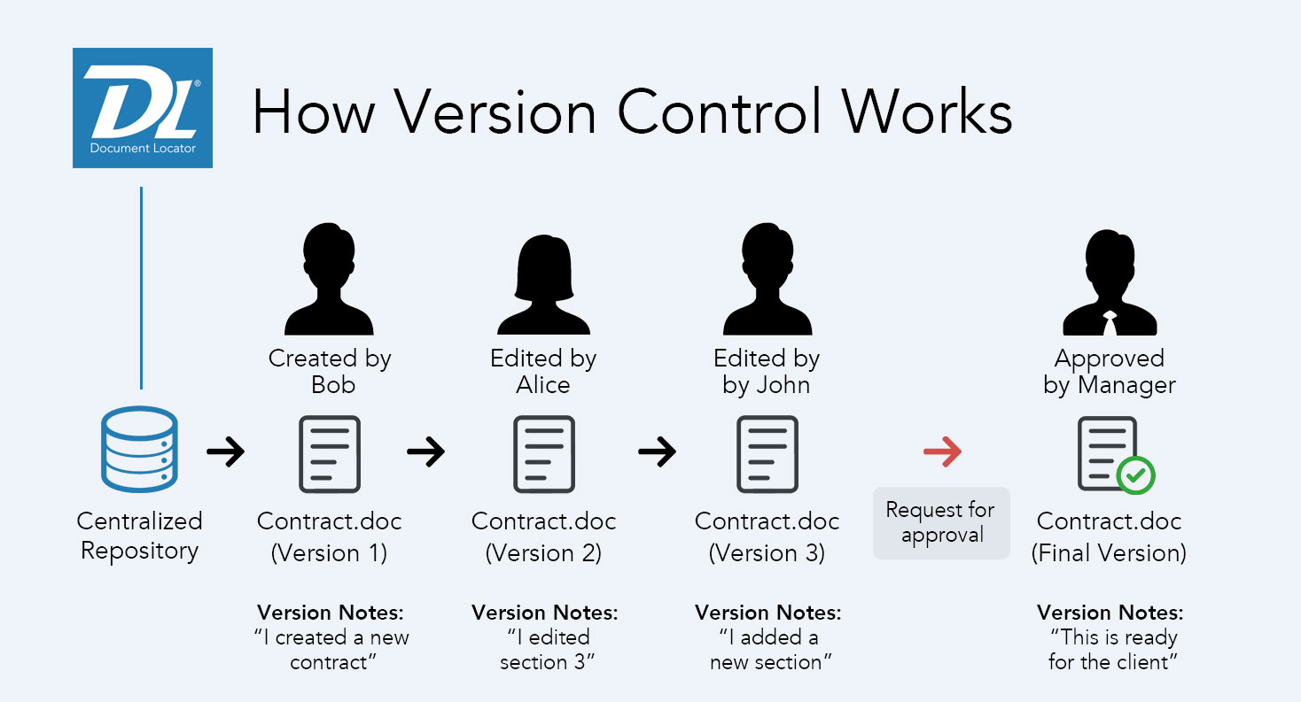

Slide 40
Key Features of a VCS
Tracking Changes: Records every change made to files, along with who made the change and why.
Collaboration: Enables multiple developers to work on the same project without overwriting each other's work.
Branching and Merging: Lets developers create separate branches to work on features or fixes, then merge them back into the main codebase.
History and Rollback: Maintains a history of changes so you can revert to previous versions if something goes wrong.

Slide 41
Types of Version Control Systems
Local VCS: Keeps track of changes on a local machine (e.g., RCS).
Centralized VCS: Uses a central server to store all versions (e.g., Subversion, CVS).
Distributed VCS: Every developer has a full copy of the repository (e.g., Git, Mercurial).

Slide 42
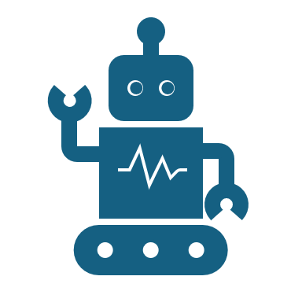
Popular VCS Tools
Git (most widely used today)
Subversion (SVN)
Mercurial
Perforce

Slide 43
Quality Control System- SonarQube
SonarQube is an open-source platform used for continuous inspection of code quality. It helps developers and teams detect bugs, vulnerabilities, and code smells in their source code.
It performs static analysis of code to detect bugs, vulnerabilities, and "code smells" (suboptimal code structures or practices) across many programming languages.

Slide 44
Key Features of SonarQube
Static Code Analysis: Scans code without executing it to find issues.
Supports Multiple Languages: Java, C#, JavaScript, Python, PHP, and many more.
Quality Gates: Defines rules that code must pass before being considered production-ready.
Integration with CI/CD: Works with Jenkins, GitHub Actions, Azure DevOps, etc.
Customizable Rules: Allows teams to set their own coding standards.
Visualization: Provides dashboards and reports to track code quality over time.
Security Analysis: Identifies security hotspots and vulnerabilities.

Slide 45
Quality Control System- SonarQube
It provides detailed reports on various aspects of your codebase,
Bugs: Actual errors that could cause your software to malfunction.
Vulnerabilities: Security weaknesses that could be exploited.
Code Smells: Indicators of potential design problems or maintainability issues.
Duplicated Code: Identifies redundant code blocks.
Code Coverage: Shows how much of your code is covered by automated tests.
Code Complexity: Measures how difficult your code is to understand and maintain.

Slide 46
Typical Use Cases
Maintaining clean, secure, and maintainable codebases.
1
Ensuring code quality in large projects.
2
Automating code reviews.
3
Enforcing coding standards across teams.
4
Tracking technical debt and maintainability.
5

Slide 47
Automate Build –Java Project
Maven is a build automation and project management tool primarily used for Java projects, and it plays a key role in Continuous Integration (CI) pipelines.
Compile your code
Run tests
Package your application (e.g., into a .jar or .war file)
Manage dependencies (external libraries your project needs)
Generate reports and documentation
In a CI environment (like Jenkins, GitHub Actions, GitLab CI), Maven is used to automate the build and test process every time code is pushed to a repository.

Slide 48

CI Workflow with Maven
1) Code Commit → Developer pushes code to Git.
2) CI Triggered → CI tool detects the change.
3) Maven Build → CI runs mvn clean install or similar:
Cleans previous builds
Downloads dependencies
Compiles code
Runs unit tests
Packages the app
4) Feedback → CI provides results (pass/fail, test coverage, etc.)

Slide 49
Automate Build C++ Project
1. Cmake
- Most popular build system for C++
- Generates native build files (Makefiles, Visual Studio projects, etc.)
- Supports cross-platform builds
- Works well with CI tools like Jenkins, GitHub Actions
2. Make / GNU Make
- Traditional build automation tool
- Uses Makefile to define build rules
- Simple but powerful for small to medium projects
3. Conan
- Dependency manager for C++
- Similar to Maven’s dependency management
- Works with CMake and other build systems
- Supports versioning, remote repositories, and package creation
4. Ninja
- Small, fast build system
- Often used with CMake as a backend
- Optimized for speed and parallel builds
5. Bazel
- Build tool from Google
- Supports multiple languages including C++
- Scalable for large codebases

Slide 50
CI Integration for C++ Projects
CMake to configure and generate build files
Conan to manage dependencies
CTest or other testing frameworks (like Google Test)
CI tools (Jenkins, GitHub Actions) to automate builds and tests

Slide 51
Sample CI pipeline setup for a C++ project
Sample CI pipeline setup for a C++ project using CMake and Conan, integrated with GitHub Actions. This setup automates building, dependency management, and testing.
Project Structure Example
my_cpp_project/
├── CMakeLists.txt
├── conanfile.txt
├── src/
│ └── main.cpp
├── tests/
│ └── test_main.cpp
└── .github/
└── workflows/
└── ci.yml

Slide 52
conanfile.txt (Dependency Management)
--------------------------------------
[requires]
gtest/1.14.0
[generators]
cmake
CMakeLists.txt (Build Configuration)
--------------------------------------
cmake_minimum_required(VERSION 3.15)
project(MyCppProject)
include(${CMAKE_BINARY_DIR}/conanbuildinfo.cmake)
conan_basic_setup()
add_executable(my_app src/main.cpp)
add_executable(my_tests tests/test_main.cpp)
target_link_libraries(my_tests ${CONAN_LIBS})
enable_testing()
add_test(NAME MyTests COMMAND my_tests)
.github/workflows/ci.yml (GitHub Actions CI Pipeline)
------------------------------------------------------
name: C++ CI Pipeline
on:
push:
branches: [ main ]
pull_request:
branches: [ main ]
jobs:
build:
runs-on: ubuntu-latest
steps:
- name: Checkout code
uses: actions/checkout@v3
- name: Install Conan
run: |
pip install conan
conan profile detect
- name: Install dependencies
run: conan install . --build=missing
- name: Configure CMake
run: cmake -S . -B build
- name: Build project
run: cmake --build build
- name: Run tests
run: ctest --test-dir build

